Slide 1
Replicated Softmax: an Undirected Topic model
From NIPS 2009
20130325

Slide 2
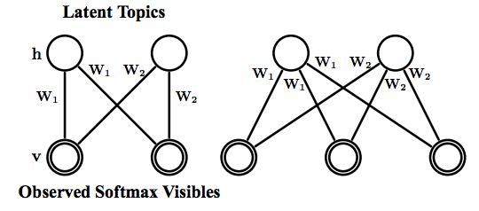

Generative Model
K: words count in the dictionary
D: documents count
F: hidden layer units count

Slide 3

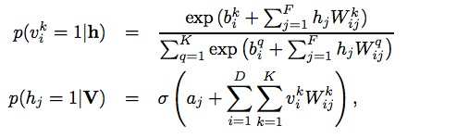

V is K x D matrix

Slide 4
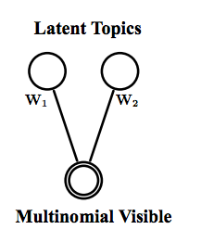


Slide 5
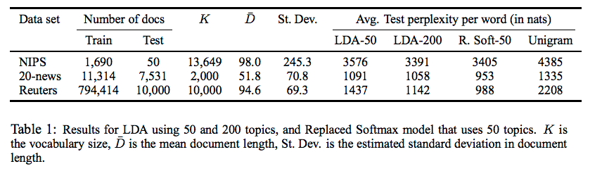
Experiments
Dataset
NIPS paper contais 1740 paper
20-newsgroup corpus contains 18845 postings
Reuters Corpus contains 804,414 news

Slide 6
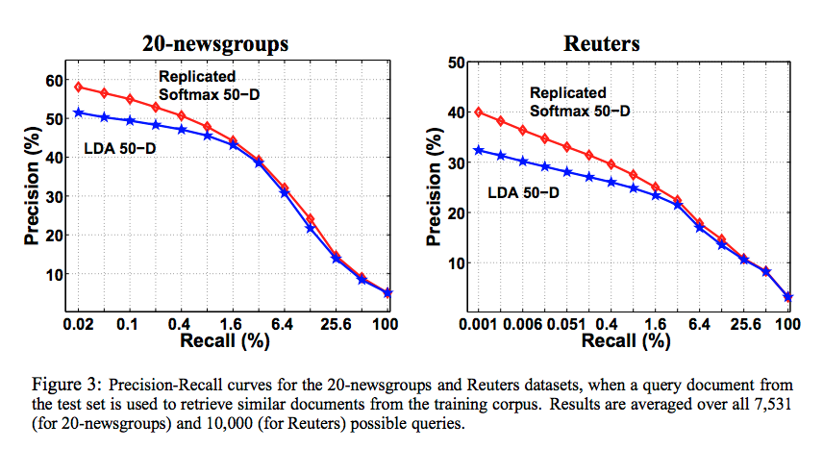
Use cosine function to measure the similarity between these two models.

